Slide 1
Installing Applications
Chia-Hung Tsai

Slide 2
Overview
Two technologies
  Packages
  Ports
Packages
  contains pre-compiled copies of all the commands for the application, as well as any configuration files or documentation
Ports
  a collection of files designed to automate the process of compiling an application from source code
Both packages and ports understand dependencies

Slide 3
Overview
Package benefits
  tarball is typically smaller
  Packages do not require any additional compilation
Ports benefits
  you can tweak the compilation options to generate code that is specific to a different processor
  Some applications have compile time options relating to what they can and cannot do

Slide 4
Package System
pkg_add(1)
  pkg_add pkg_name
  # pkg_add lsof-4.56.4.tgz
  pkg_add -r pkg_name
    If you don’t have a source of local packages
    If you are using FreeBSD-CURRENT or FreeBSD-STABLE, pkg_add will download the latest version of your application
    If your are using FreeBSD-RELEASE, it will grab the version of the package that was built with your release
    PACKAGESITE environment variable

Slide 5
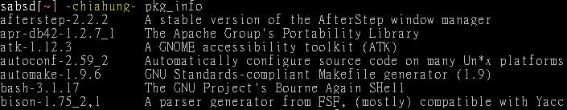
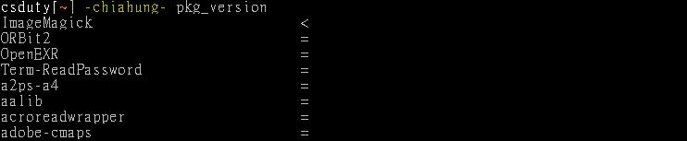
Managing Packages
pkg_info(1)
pkg_version(1)
pkg_delete(1)
# pkg_delete xchat-1.7.1

Slide 6
Ports system
Find your application
  cd /usr/ports
  make search name=program name
  make search key=string
change to the directory for the port you want to install
Type “make install clean” to install your application
  make
  make install
  make clean

Slide 7
Ports system
When your type “make”, the ports system uses fetch(1) to download the files
  MASTER_SITES environment variable
  make MASTER_SITE_OVERRIDE= \ ftp://ftp.FreeBSD.org/pub/FreeBSD/ports/distfiles/ fetch
  /etc/make.conf
Using pkg_delete pkg_name to delete your application

Slide 8
Obtaining the Ports Collection
sysinstall
cvsup (or csup, … etc)
cd-rom
Using cvsup to update your ports collection

Slide 9
Upgrading Ports using portupgrade
pkg_version -v
portupgrade
  The utility is designed to easily upgrade installed ports
  cd /usr/ports/sysutils/portupgrade; make install clean
  portupgrade -a
  Portupgrade -R firefox

Slide 10
portaudit
portaudit
  check if installed ports are listed in a database of published security vulnerabilities
  portinstall portaudit
  portaudit -Fa

Slide 11
Installation failed
cvsup ports tree
/usr/ports/UPDATING
portsdb -Fu
  Generate the ports database named INDEX.db from INDEX
pkgdb -F
  An interactive tool for fixing the package registry database
portupgrade -aR
portinstall again

